Slide 1
Working with Sequential Data Attention
Alexey Zaytsev
Rodrigo Rivera
January, 2020

Slide 2
Sequence-to-sequence models
Sequence-to-sequence models are deep learning models that have achieved a lot of success in tasks like machine translation, text summarization, and image captioning.
Google Translate started using such a model in production in late 2016.
These models are explained in the two pioneering papers (Sutskever et al., 2014, Cho et al., 2014).
A sequence-to-sequence model is a model that takes a sequence of items and outputs another sequence of items.

Slide 3
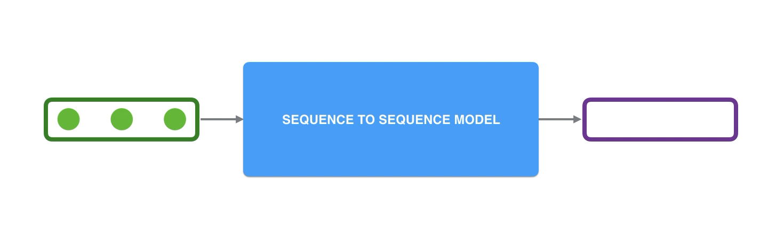
Sequence-to-sequence models

Slide 4
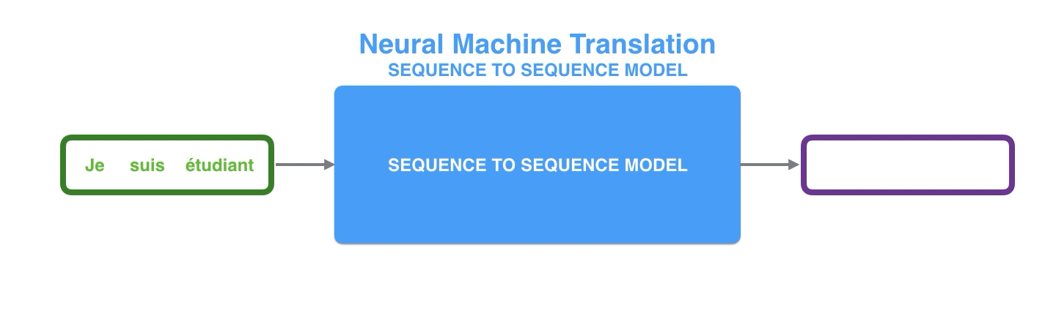
Sequence-to-sequence models
In neural machine translation, a sequence is a series of words, processed one after another. The output is, likewise, a series of words:

Slide 5
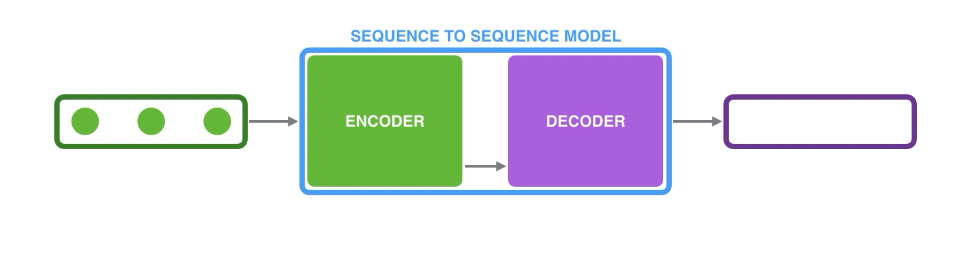
Sequence-to-sequence models
The model is composed of an encoder and a decoder.
The encoder processes each item in the input sequence, it compiles the information it captures into a vector (called the context).
After processing the entire input sequence, the encoder send the context over to the decoder, which begins producing the output sequence item by item.

Slide 6
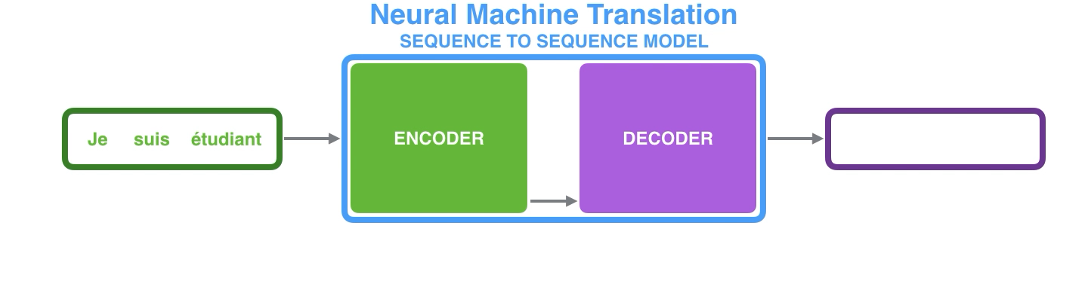
Sequence-to-sequence models
The same applies in the case of machine translation.

Slide 7
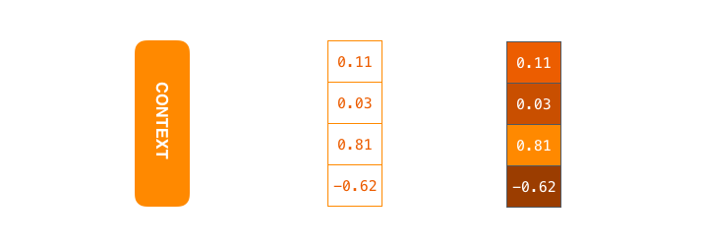
Sequence-to-sequence models
The context is a vector in the case of machine translation.
The encoder and decoder tend to both be recurrent neural networks
Set the size of the context vector when setting up the model.
It is basically the number of hidden units in the encoder RNN.
These visualizations show a vector of size 4, but in real world applications the context vector would be of size 256, 512, or 1024.

Slide 8
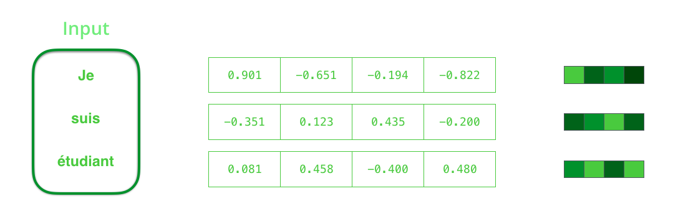
Sequence-to-sequence models
A RNN takes two inputs at each time step:
an input (in the case of the encoder, one word from the input sentence),
and a hidden state.
The word, however, needs to be represented by a vector. To transform a word into a vector, one uses “word embedding” algorithms. These turn words into vector spaces that capture semantic information of the words (e.g. king - man + woman = queen).

Slide 9
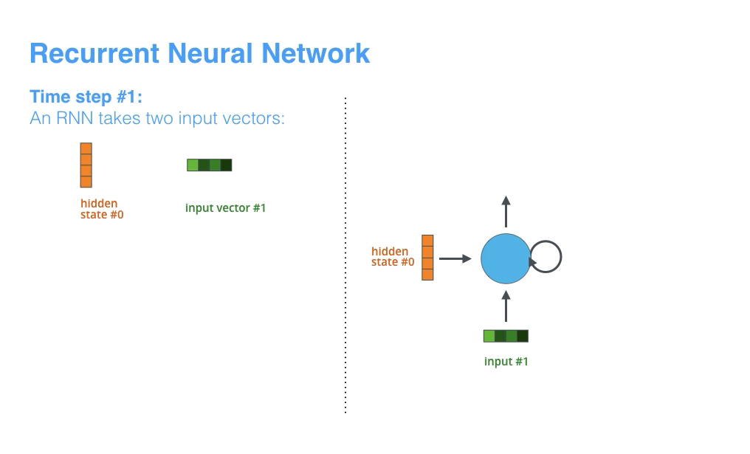
Sequence-to-sequence models

Slide 10
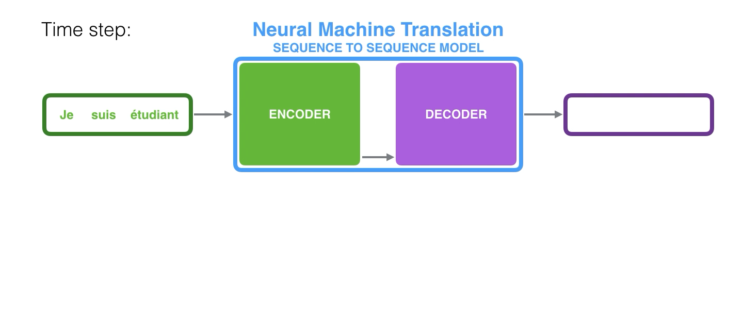
Sequence-to-sequence models
Each pulse for the encoder or decoder is that RNN processing its inputs and generating an output for that time step.
Since the encoder and decoder are both RNNs, each time step one of the RNNs does some processing, it updates its hidden state based on its inputs and previous inputs it has seen.
Notice how the last hidden state of the encoder is actually the context we pass along to the decoder.

Slide 11
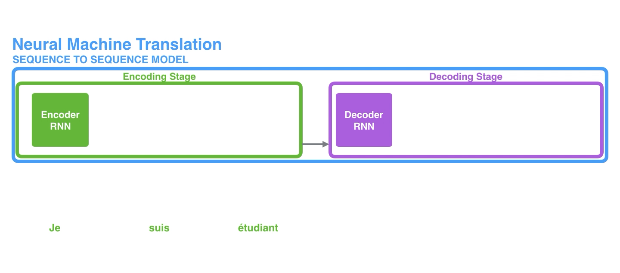
Sequence-to-sequence models
The decoder also maintains hidden states that it passes from one time step to the next.
Another way to visualize a sequence-to-sequence model is with a so-called “unrolled” view where instead of showing the one decoder, we show a copy of it for each time step.
This way we can look at the inputs and outputs of each time step.

Slide 12
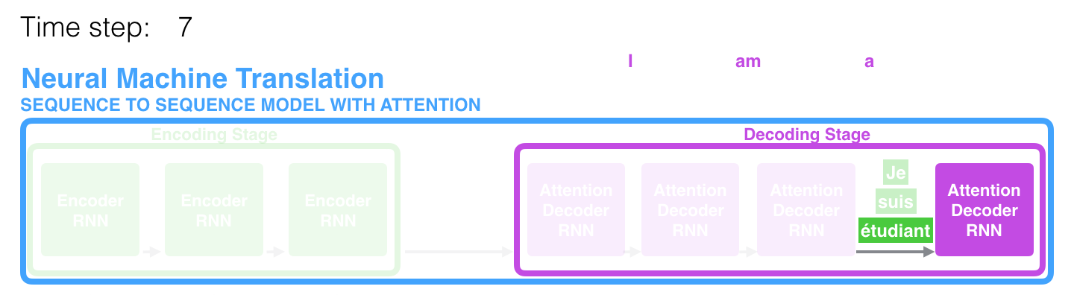
Attention
The context vector turned out to be a bottleneck for these types of models.
It made it challenging for the models to deal with long sentences.
A solution was proposed in Bahdanau et al., 2014 and Luong et al., 2015.
These papers introduced and refined a technique called “Attention”, which highly improved the quality of machine translation systems.
Attention allows the model to focus on the relevant parts of the input sequence as needed.

Slide 13
Attention
At time step 7, the attention mechanism enables the decoder to focus on the word "étudiant" ("student" in french) before it generates the English translation.
This ability to amplify the signal from the relevant part of the input sequence makes attention models produce better results than models without attention.

Slide 14
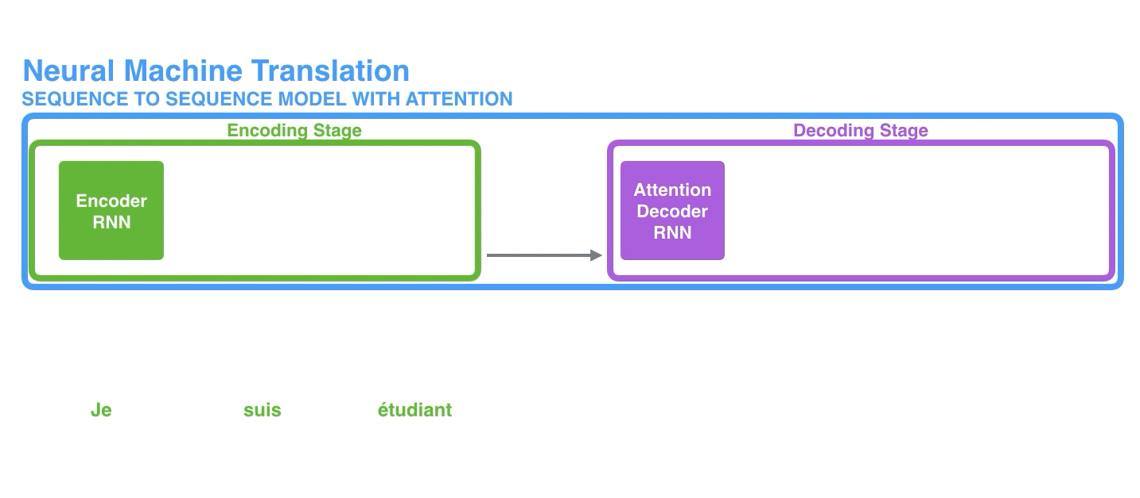
Attention
An attention model differs from a classic sequence-to-sequence model in two main ways:
First, the encoder passes a lot more data to the decoder. Instead of passing the last hidden state of the encoding stage, the encoder passes all the hidden states to the decoder:

Slide 15
Attention
Second, an attention decoder does an extra step before producing its output. In order to focus on the parts of the input that are relevant to this decoding time step, the decoder does the following:
Look at the set of encoder hidden states it received, each encoder hidden states is most associated with a certain word in the input sentence
Give each hidden states a score (ignore how the scoring is done for now)
Multiply each hidden states by its softmax score
Amplify hidden states with high scores
Drown out hidden states with low scores

Slide 16
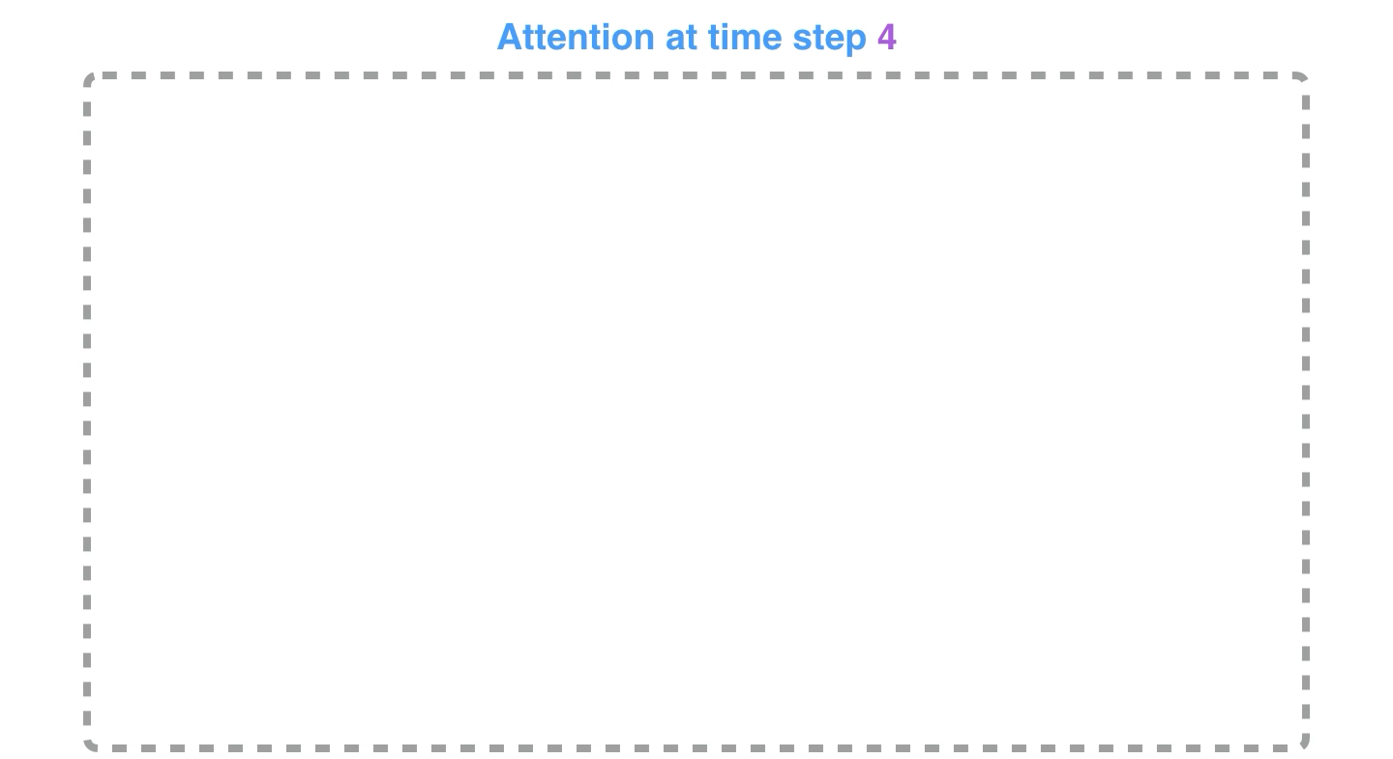
Attention

Slide 17
Attention
This scoring exercise is done at each time step on the decoder side.
How the attention process works:
The attention decoder RNN takes in the embedding of the <END> token, and an initial decoder hidden state.
The RNN processes its inputs, producing an output and a new hidden state vector (h4)
The output is discarded.
Attention Step: Use the encoder hidden states and the h4 vector to calculate a context vector (C4) for this time step.
Concatenate h4 and C4 into one vector.
Pass this vector through a feedforward neural network (one trained jointly with the model).
The output of the feedforward neural networks indicates the output word of this time step.
Repeat for the next time steps

Slide 18
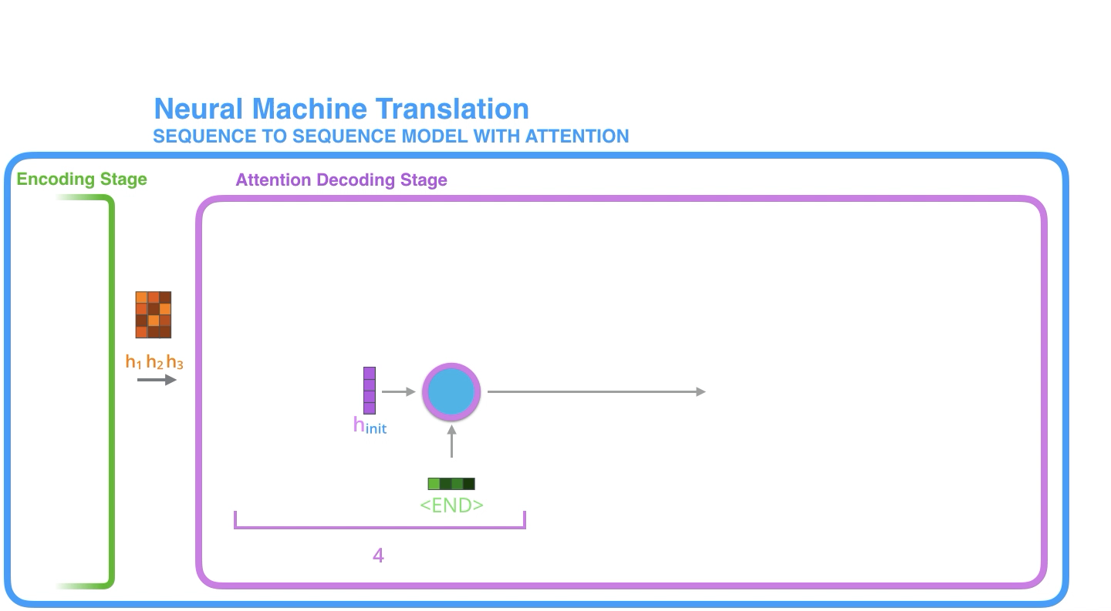
Attention

Slide 19
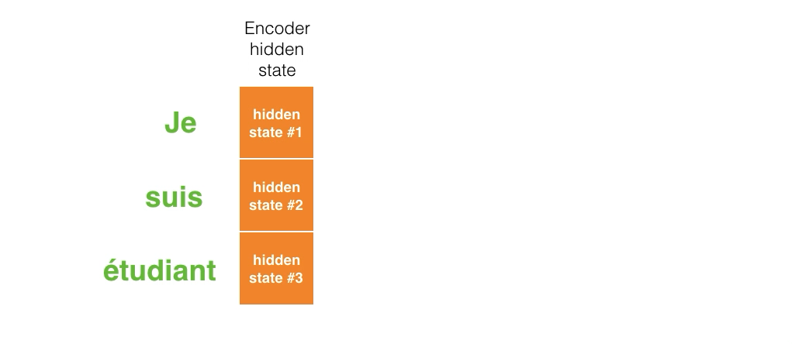
Attention
Another way to look at which part of the input sentence we’re paying attention to at each decoding step:

Slide 20
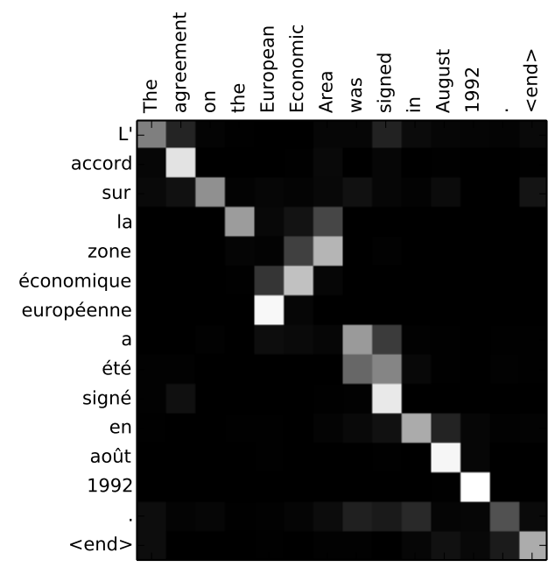
Attention
The model is not mindless aligning the first word at the output with the first word from the input.
It learned from the training phase how to align words in that language pair (French and English in the example).
An example for how precise this mechanism can be:

Slide 21
Questions?

Slide 22
Sources
https://jalammar.github.io/visualizing-neural-machine-translation-mechanics-of-seq2seq-models-with-attention/
http://nlp.seas.harvard.edu/2018/04/03/attention.html
https://jalammar.github.io/illustrated-transformer/

